Slide 1
Proprioceptive neuromuscular facilitation (PNF)

Slide 2
PNF stretching, or proprioceptive neuromuscular facilitation stretching
PNF stretching, or proprioceptive neuromuscular facilitation stretching, is a set of stretching techniques commonly used in clinical environments to enhance both active and passive range of motion in order to improve motor performance and aid rehabilitation.
PNF is considered an optimal stretching method when the aim is to increase range of motion, especially as regards short-term changes.
Generally an active PNF stretch involves a shortening contraction of the opposing muscle to place the target muscle on stretch.

Slide 3
PNF stretching, or proprioceptive neuromuscular facilitation stretching
This is followed by an isometric contraction of the target muscle.
PNF can be used to supplement daily stretching and to make quick gains in range of motion – for example, to help athletes improve performance.
In addition to being safe and time efficient, the rapidly achievable gains in range of motion may also help promote compliance with the exercise and rehabilitation program.

Slide 4
Herman Kabat, a neurophysiologist, to develop the clinical PNF stretching technique using natural movement patterns.
He knew of the myotatic stretch reflex which causes a muscle to contract when lengthened too quickly, and of the inverse stretch reflex, which causes a muscle to relax when its tendon is pulled with too much force.
He believed combinations of movement would be better than the traditional moving of one joint at a time.

Slide 5
Initial PNF techniques were used to aid the rehabilitation of clients with spasticity and weakness by facilitating muscle elongation.
This is theorized to be accomplished through enhanced inhibitory mechanisms affecting the spastic muscle, and improving the muscle strength through improved excitation mechanisms in the weakened muscle.

Slide 6
Inverse stretch reflex
The Golgi tendon reflex operates as a protective feedback mechanism to control the tension of an active muscle by causing relaxation before the tendon tension becomes high enough to cause damage.
The stretch reflex operates as a feedback mechanism to control muscle length by causing muscle contraction. In contrast, the tendon reflex operates as a feedback mechanism to control muscle tension by causing muscle relaxation before muscle force becomes so great that tendons might be torn.

Slide 7
Introduction
What is PNF ? Proprioceptive Neuromuscular Facilitation (PNF) is a more advanced form of flexibility training that involves both the stretching and contraction of the muscle group being targeted.

Slide 8
Introduction
PNF stretching was originally developed as a form of rehabilitation, is a strengthening technique based on human anatomy, neurophysiology, and kinesiology.
It is used to increase muscle strength, flexibility, and ROM.

Slide 9
Introduction
Physiology
- PNF exercises are based on the stretch reflex which is caused by stimulation of the Golgi tendon and muscle spindles. This stimulation results in impulses being sent to the brain, which leads to the contraction and relaxation of muscles.

Slide 10
Introduction
When a body part is injured, there is a delay in the stimulation of the muscle spindles and Golgi tendons resulting in weakness of the muscle. PNF exercises help to re-educate the motor units which are lost due to the injury

Slide 11
Introduction
History
The method of PNF:
Greatest emphasis was placed on the application of maximal resistance throughout the range of motion using many combinations of motions, which allowed for tow component actions at tow or more joints.

Slide 12
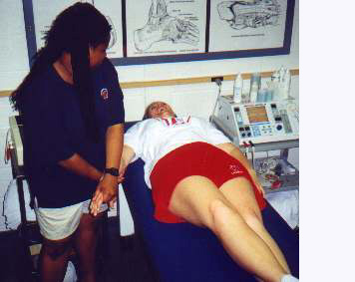
Introduction
D1fl upper extremity movement pattern

Slide 13
Introduction
The method:
Patient contract isometrically resulted in increased response of the agonist, this was named rhythmic stabilization. Following using this stabilization, it was found slow reversal technique, alternate resistance to isotonic contractions of antagonist and agonist also had a facilitating effect.

Slide 14
Introduction
Definitions of PNF:
Proprioceptive, means receiving stimulation
within the tissues of the body.
Neuromuscular, means pertaining to the nerves and muscles.
Facilitation, means the effect produced in nerve tissue by the passage of an impulse.

Slide 15
Introduction
Definitions of PNF:
Therefore, PNF can be defined as, methods of promoting or hastening the response of the neuromuscular mechanism through stimulation of the proprioceptors.

Slide 16
Introduction
To perform PNF exercises, it is important to remember the following
principles:
Patient must be taught the pattern.
Have the patient watch the moving limb moved passively.
The patient must give proper verbal command.
Manual contact with appropriate pressure is very important.

Slide 17
Introduction
Principles:
Contraction of the muscle group is facilitated by hand placement.
Apply maximal resistance throughout ROM.
Resistance will change.
Rotation of movement will change throughout ROM.
Distal movement should occur first .

Slide 18
Introduction
Plan of volume:
Patterns of motion
Various techniques used to promote the desired response
Application of the method for improvement of vital and related functions.
Suggestions for evaluation of the patient performance and for planning treatment program.

Slide 19
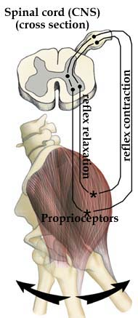
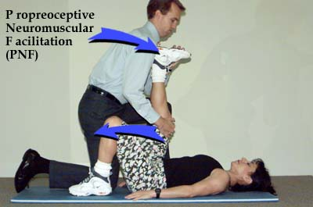
PNF Stretching Proprioceptive Neuromuscular Facilitation
PNF allows the muscle to be stretched to a greater degree by increasing the proprioceptor signals through a 5- to 10-second voluntary muscle contraction followed by a 5- to 10-second voluntary muscle relaxation. With the hold-relax PNF method, the muscle is placed into a static stretch. The athlete is instructed to "hold" and contract the muscle against resistance from a partner for 10 seconds. The athlete is then instructed to "relax," and the partner slowly moves the muscle to a new static position. The technique is repeated two to three times.

Slide 20
Proprioceptive Neuromuscular Facilitation (PNF)
First used by ATC’s rehabilitating neuromuscular disorders
More recently used to increase flexibility
3 types of PNF stretching techniques
Contract relax: beneficial to athletes where ROM is limited by muscle tightness
Athlete actively contracts agonist to point of limitation, athlete then instructed to contract antagonist (muscle to be stretched) isotonically (through range of motion), athlete then relaxes as ATC passively moves part to point of limitation. Stretch is then repeated

Slide 21
Proprioceptive Neuromuscular Facilitation (PNF)
Hold relax: Similar to contract relax except antagonist goes through isometric contraction (contraction w/o movement)
Hold for at least 6 seconds
Can be used for agonist or antagonist
Slow reversal-hold-relax
Begins with isotonic contraction of agonist, followed by isometric contraction of antagonist
During relax phase antagonist are relaxed while agonist are contracting

